Slide 1
Microservices Architecture:
A Paradigm Shift
2024年03月01日
セイコーエプソン株式会社
DX推進本部 IT企画設計部
発表者 氏名 : タマン・ニルマル

Slide 2
目次
Introduction
Key characteristics
Monolithic vs Microservices
Monolithic Architecture
Benefits : Why Monolith First
Challenges
Microservices Architecture
Benefits
Challenges

Slide 3
Introduction
What are Microservices?
Microservices are an architectural style for designing software applications as independently deployable services.
Each service runs in its own process and communicates via lightweight mechanisms, often using an HTTP resource API.
These services are organized around business capabilities and can be written in different programming languages with varying data storage technologies.

Slide 4
Key Characteristics
Decentralization: Microservices avoid central control, allowing teams to work independently on specific services.
Independently Deployable: Each service can be deployed separately, enabling faster releases and updates.
Business Capability Focus: Services align with specific business functions, promoting modularity and maintainability.
Automated Deployment: Continuous integration and deployment pipelines ensure efficient delivery.
Intelligence at Endpoints: Services handle their logic, minimizing centralized decision-making.
Language and Data Diversity: Microservices can use different languages and databases.
Lightweight Communication: Typically, services communicate via HTTP APIs.
Small Collaborating Services: Services work together to achieve overall system functionality.
Decentralized Management: Minimal centralized control over services.

Slide 5
Monolithic vs. Microservices
Monolithic Architecture:
Built as a single unit.
Client-side UI, database, and server-side application tightly coupled.
Difficult to scale and maintain.

Slide 6
Benefits : Monolith First
Yagni (You Aren’t Gonna Need It):
Start simple to prevent premature optimization
Prioritizing speed and feedback
Avoid unnecessary overhead
2. Boundary Exploration and Bounded Contexts:
explore and discover the right boundaries
3. Gradual Evolution:
Monolithic → Microservice is smooth
Adaptive to new insights

Slide 7
Challenges of Monolithic Architecture
Tight coupling:
Coupled within single codebase
Change in one area can affect other parts
2. Complex Deployment:
Large scale deployment
Require intensive resources
3. Lack of independence:
Struggle in evolving
Hinders faster release cycle

Slide 8
Monolithic vs. Microservices
Microservices Architecture:
Composed of small, independent services.
Composed of small, independent services.
Easier to scale, maintain, and evolve.

Slide 9
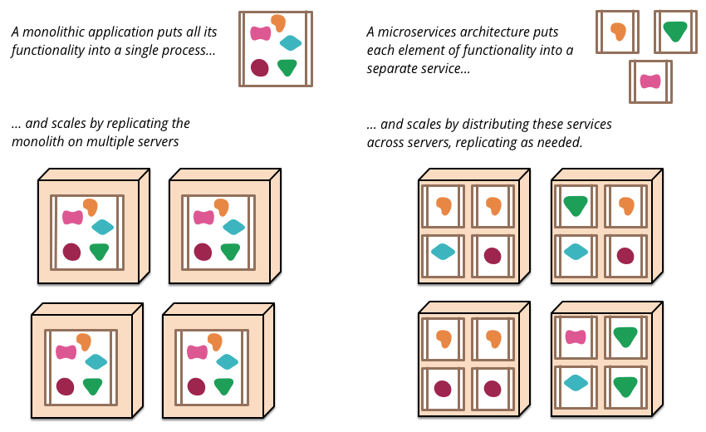
Scaling : Monolithic vs. Microservices

Slide 10
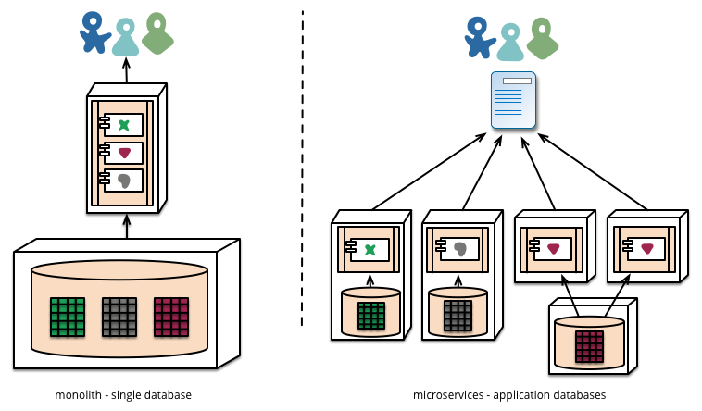
Topology: Monolithic vs. Microservices

Slide 11
Benefits
Scalability: Scale individual services as needed.
Resilience: Failures in one service don’t affect others.
Agility: Faster development and deployment cycles.
Technology Heterogeneity: Choose the right tools for each service.
Team Autonomy: Independent teams manage services.
Evolvability: Easier to evolve and adapt.

Slide 12
Challenges
Distributed Complexity: Managing multiple services.
Service Discovery: Finding and connecting services.
Data Consistency: Ensuring consistency across services.
Testing and Monitoring: Comprehensive testing and monitoring.
Operational Overhead: Managing deployments and infrastructure.

Slide 13


